Slide 1
Site Training
Annual Required Training
2020-2021
Notes:
Welcome! Thank you for participating in the CACFP orientation. I’m going to wait a few minutes to get started, please make sure your microphone is muted. If you have any questions during the presentation, please feel free to write a chat. There will also be time at the end for any questions or concerns.

Slide 2
Introduction
Thank you for being a participating site!
Please sign in on the training roster
Introductions
Notes:
Hello let’s get started! My name is Sandy, and I am the Program and Agency Relations Manager at Food Bank of Alaska. I will be your contact until the position of Program Coordinator – Children is filled. Let’s go ahead and do roll call, please introduce yourself, if you are a Site Manager or Monitor and what community you are representing.

Slide 3
Child and Adult Care Food Program
CACFP is a federally funded nutrition assistance program that plays a vital role in improving the quality of day care in the U.S. Each day, 3.2 million children receive nutritious meals and snacks through CACFP. 112,000 adults who receive care in nonresidential adult day care centers also receive meals daily. The CACFP is administered through grants to States. The Alaska Dept. of Education & Early Development, Child Nutrition Programs administers the CACFP and has agreements with participating programs.
Notes:
CACFP is a federally funded nutrition assistance program that plays a vital role in improving the quality of day care in the U.S. Each day, 3.2 million children receive nutritious meals and snacks through CACFP. 112,000 adults who receive care in nonresidential adult day care centers also receive meals daily. CACFP is administered through grants to States. The Alaska Dept. of Education & Early Development, Child Nutrition Programs administers the CACFP and has agreements with participating programs.

Slide 4
General Responsibilities of CACFP Programs
Serve healthy meals that are in alignment with USDA meal patterns
Keep daily records of participants in attendance and quantities of meals served.
Follow all health and safety requirements per federal, state, and local authorities
Comply with all CACFP regulations and the Alaska Department of Education.
Notes:
Serve healthy meals that are in alignment with USDA meal patterns
Keep daily records of participants in attendance and quantities of meals served.
Follow all health and safety requirements per federal, state, and local authorities
Comply with all CACFP regulations and the Alaska Department of Education.

Slide 5
Civil Rights
Ensuring All Children Have Equal Access to Meals

Slide 6
USDA Policy
All institutions participating in or administering USDA programs are prohibited from discriminating.
Notes:
In accordance with Federal civil rights law and U.S. Department of Agriculture (USDA) civil rights regulations and policies, the USDA, its Agencies, offices, and employees, and institutions participating in or administering USDA programs are prohibited from discriminating based on race, color, national origin, religion, sex, disability, age or reprisal or retaliation for prior civil rights activity, in any program or activity conducted or funded by USDA. Civil Rights training is to be conducted annually as a requirement programs the administer USDA programs

Slide 7
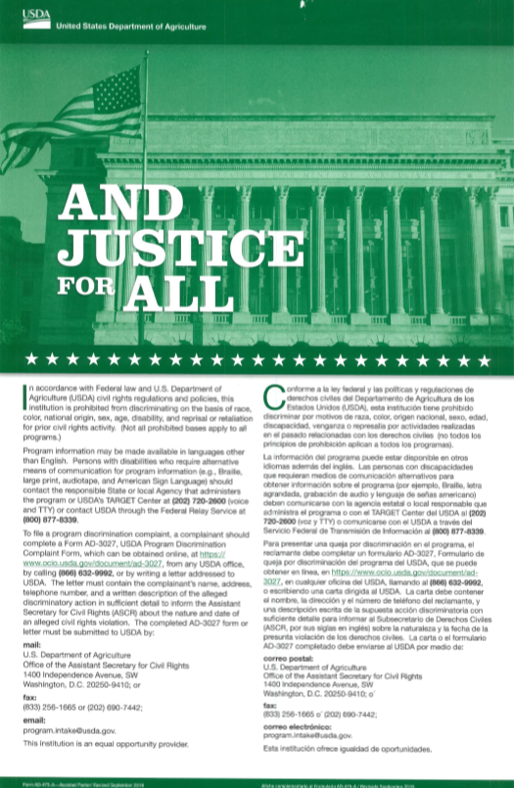
And Justice For All Poster
All sites must display the most current “And Justice for All” poster:
In the food service area.
In a location that is easily visible to students and the public.
If you need a poster, please inform FBA.
Notes:
All sites must display the most current “And Justice for All” poster:
In the food service area.
In a location that is easily visible to students and the public.
If you need a poster, please inform FBA.
Poster must be outside if the parent is picking up the meals outside of the building.

Slide 8
Reasonable Accommodations
Sponsors are required to make reasonable accommodations for children with disabilities.
If you have children with disabilities wishing to participate but need accommodations, let FBA know.
Notes:
Sponsors are required to make reasonable accommodations for children with disabilities.
However, they are not expected to make accommodations that are so expensive or difficult that it would cause the sponsor undue hardship. In most cases, children with disabilities can be accommodated with little expense or difficulty. If you have children with disabilities wishing to participate but need accommodations, let FBA know.

Slide 9
LIMITED English Proficiency
Take reasonable steps to ensure meaningful access to services for limited English individuals
Ensure that translations are accurate concerning the availability and nutritional benefits of the Program.
Make reasonable modifications in policies and procedures to ensure individuals with disabilities have equal access and effective communication when accessing CACFP.
Notes:
Take reasonable steps to ensure meaningful access to services for limited English individuals by providing information in the frequently encountered, non-English languages.
Ensure that translations are accurate concerning the availability and nutritional benefits of the Program;
Make reasonable modifications in policies and procedures to ensure individuals with disabilities have equal access and effective communication when accessing the Program.

Slide 10
Nondiscrimination Statements and Complaints
Include the nondiscrimination statement in your public release and in any program:
[ site name ] does not and shall not discriminate on the basis of race, color, national origin, religion, sex, disability, age or reprisal or retaliation for prior civil rights activity, in any program or activity conducted or funded by USDA.
Notes:
Include the nondiscrimination statement, in your public release and in any program information (flyers websites etc.. ) directed to parents of participants and potential participants. If you have someone wanting to file a civil rights complaint you should also direct them to FBA. All complaints will be investigated by the Program Coordinator or Program Manager and occasionally the State of Alaska if it cannot be handled on our level.

Slide 11
Food Safety

Slide 12
Food Safety Overview
The following three sections promote key food safety practices essential to a successful site:
Practicing good personal hygiene.
Checking and documenting food safety temperatures.
Store food in 50-70 degrees Fahrenheit
Proper cleaning and sanitizing.
Notes:
Please keep in mind that the information presented in this training may or may not apply to all meal sites, so adapt it to your program as applicable.
The following three sections promote key food safety practices essential to a successful site:
Practicing good personal hygiene.
Checking and documenting food safety temperatures.
Proper cleaning and sanitizing.

Slide 13
Personal Hygiene
Personal hygiene is especially important for keeping food safe. This includes restricting or excluding ill staff from preparing or handling food, using effective handwashing procedures, and eliminating bare hand contact with ready-to-eat foods.
Notes:
Personal hygiene is especially important for keeping food safe. This includes restricting or excluding ill staff from preparing or handling food, using effective handwashing procedures, and eliminating bare hand contact with ready-to-eat foods. Using all three practices together will help prevent foodborne illness at a meal service site. Each practice will be covered more in the following slides.
Good personal hygiene begins with arriving to a site properly dressed. This minimizes possible contamination from dirty clothes or people. When working for a site, follow these guidelines for proper attire.

Slide 14
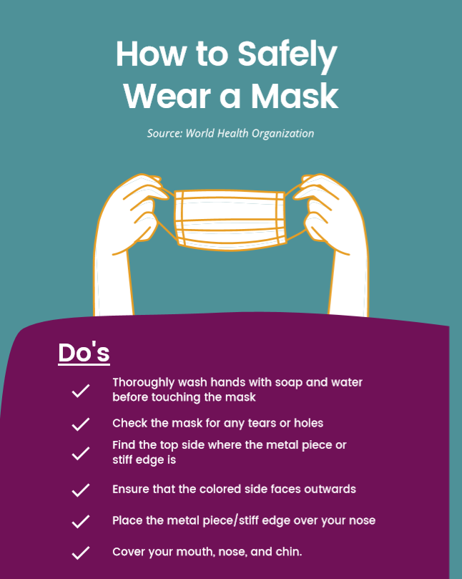
Personal Hygiene Tips
Wear close-toed shoes
Restrain your hair
Trim nails
Wear a cloth or disposable face mask
Follow any guidance from the local health authority regarding proper attire.

Slide 15
Employee Health
Report these illness symptoms:
Vomiting
Diarrhea
Sore throat with fever
Jaundice (yellowing of the skin and eyes)
Open cuts, sores, or wounds
Foodborne illness diagnosed by doctor
COVID-19 symptoms
Notes:
If you are sick, you may spread your illness to those around you such as other staff and children. Staff should notify the Site Manager if they are feeling sick or have any COVID-19 symptoms. Report these illness symptoms:
Vomiting
Diarrhea
Sore throat with fever
Jaundice (yellowing of the skin and eyes)
Open cuts, sores, or wounds
Foodborne illness diagnosed by doctor
COVID-19 symptoms

Slide 16
Handwashing
Follow these steps for proper handwashing:
Wet hands with water and soap.
Lather hands with soap up to elbows and scrub for 10-15 seconds.
Wash backs of hands, wrists, between fingers, and under fingernails.
Rinse hands under running water.
Dry hands with paper towel(s) or air dryer.
Turn off water with paper towel(s). If applicable, open the door with the paper towel, and then discard it into trashcan.
Notes:
Keeping hands clean is one of the most important steps you can take to avoid spreading germs to others. Many diseases and conditions are spread by not washing hands with soap and clean, running water. Follow these steps for proper handwashing:
Wet hands with water and soap.
Lather hands with soap up to elbows and scrub for 10-15 seconds.
Wash backs of hands, wrists, between fingers, and under fingernails.
Rinse hands under running water.
Dry hands with paper towel(s) or air dryer.
Turn off water with paper towel(s). If applicable, open the door with the paper towel, and then discard it into trashcan.
We can send this sign in a PDF if you are in need of one.

Slide 17
Proper Glove Use
Always wash hands before putting on gloves.
Wear gloves when handling ready-to-eat foods.
Ready-to-eat foods are foods that can be eaten without further rinsing or cooking, such as fresh fruits and vegetables, sandwiches, and cheese.
Never re-use or wash gloves.
Dispose of soiled gloves.
Change gloves after sneezing, coughing, or touching face, hair, or other parts of the body.
Change gloves if touching something other than food, such as a cell phone, door handle, trashcan, cash register, or money.

Slide 18
Cleaning Tables, Work Surfaces, and Equipment
Be sure all food preparation occurs on a clean and sanitized surface. This reduces the risk of food becoming contaminated by microorganisms. Use a 3-step process to make sure all surfaces that encounter food are clean.
1. Wash surface with soap and water solution to clean.
2. Rinse surface with clean water to remove debris and soap.
3. Sanitize surface using a sanitizing solution mixed at the concentration specified on the manufacturer’s label. Allow items to air dry.
Notes:
This is especially helpful during COVID-19. Be sure all food preparation occurs on a clean and sanitized surface. This reduces the risk of food becoming contaminated by microorganisms. Use a 3-step process to make sure all surfaces that encounter food are clean.
1. Wash surface with soap and water solution to clean.
2. Rinse surface with clean water to remove debris and soap.
3. Sanitize surface using a sanitizing solution mixed at the concentration specified on the manufacturer’s label. Allow items to air dry.

Slide 19
Best if used by Dates on Food
Best if Used by Dates
Sell-by Dates
Pack Dates
Fd-107 Policy Memo June 9, 2010
Notes:
Best if Used by Dates – food at its peak (flavor and quality)
Sell-by Dates– manufacturer recommends that a store sell by a certain date
Pack Dates – when the product was packaged or processed

Slide 20
Additional Safety Information
Practice FIFO(first in first out).
Store your food 6 inches off the floor and 6 inches away from the wall.
Do not have anything, especially cleaning supplies, stored above your food.
Food should be stored in a manner to protect it from spoilage.
Store your food in a locked storage area.
If the meals show any signs of spoilage, infestation or other visible defects the food should not be distributed regardless of production dates. Please contact FBA immediately if you have spoiled or damaged food before taking any action.
Notes:
Use your oldest food first and newest food last; this is FIFO (first in first out) practice. Store your food 6 inches off the floor and 6 inches away from the wall. On a crate or a shelf is a good option. If your food is stored in a shared storage space such as a janitorial closet, you shouldn’t have anything, especially cleaning supplies, stored above your food. Food should be stored in a manner to protect it from spoilage, infestation, damage and any other conditions that may jeopardize the wholesomeness or safety of the foods. Store your food in a locked storage area. This prevents your food from being vandalized or stolen. If the meals show any signs of spoilage, infestation or other visible defects the food should not be distributed regardless of production dates. Please contact FBA immediately if you have spoiled or damaged food before taking any action.

Slide 21
Meal Service Requirements and paperwork

Slide 22
Meal Requirements
Each meal has the following items:
Fluid milk
Fruit/Vegetable (two kinds)
Bread/bread grain alternative
Meat/meat alternative
Notes:
The meal pattern requirements ensure that children are receiving a well-balanced meal that supply the type and amount of food required to help meet their nutrition and energy needs.
ES Foods is our vendor this year. The milk is separate from the meal so please make sure children get a milk with their meal. Depending on the meal you serve it will have a variation of the following items:
Fluid milk
Fruit/Vegetable (two kinds)
Bread/bread grain alternative
Meat/meat alternative

Slide 23
Eat Here Only Signs
Traditionally, all meals must be eaten onsite except for foods approved in Policy Memo 22-2016. However, this year if the school is closed due to a COVID-19 lockdown, the state has created waivers to allow children or parents to pick up meals and take them home.
Notes:
Traditionally, all meals must be eaten onsite except for foods approved in Policy Memo 22-2016. However, this year if the school is closed due to a COVI-19 lockdown, the state has created waivers to allow children or parents to pick up meals and take them home. If the school is in session the meals must be eaten on site as a congregate meal service. This sign is to be posted at your congregate eating site. If you do not have this sign, we can send an electronic version or mail a laminated version to you.
Feel free to encourage families to bring other children to partake in the meal service if they know others who have need.

Slide 24
Share Tables
If your site is serving in person you may want to encourage using the “share tables”. Share Tables is a strategy to reduce food waste in the Child Nutrition Programs.
Please have signs posted so kids will know where to put items they do not wish to eat instead of throwing them away. Items on the share table do not need to be counted on the daily meal count because they already have been distributed. Items must also be unopened.
Notes:
If your site is serving in person you may want to encourage the using “share tables”. Share tables is a strategy to reduce food waste in the Child Nutrition Programs. Please have signs posted so kids will know where to put items they do not wish to eat instead of throwing them away. Items on the share table do not need to be counted on the daily meal count because they already have been distributed..
Share tables are tables or stations where children may return whole food or beverage items they choose not to eat. Items must also be unopened. These food and beverage items are then available to other children who may want additional servings to eat at that time or save for later. For example, milk is served in individual cartons and a child can return an unopened milk carton to the share table. Complete meals and nonperishable components that remain on a share table may be appropriately stored for later service.
One item can be taken home from the share table

Slide 25
Daily Meal Count Form
The Site Manager should sign the daily meal count form each week and fax or email it back to FBA by Monday the following week.
If Meal Count forms are continuously not turned in to FBA, the site will have two formal warnings before disciplinary action is taken. This could result in being financially responsible for the meals and/or being suspended from the program for the rest of the season and the following year.
Damaged meals should be counted and recorded. Damaged meals are meals that are missing meal components, meals that were served incomplete, or a meal box that was damaged in transport, etc.
Notes:
The Daily meal count is the most important form. This form must be filled out when the children are served a meal, also know as Point of Service. The Site Manager should sign the daily meal count form each week and fax or email it back to FBA by Monday the following week.
If Meal Count forms are continuously not turned in to FBA, the site will have two formal warnings before disciplinary action is taken. This could result in being financially responsible for the meals and/or being suspended from the program for the rest of the season and the following year.
Damaged meals should be counted and recorded. Damaged meals are meals that are missing meal components, meals that were served incomplete, or a meal box that was damaged in transport, etc.

Slide 26
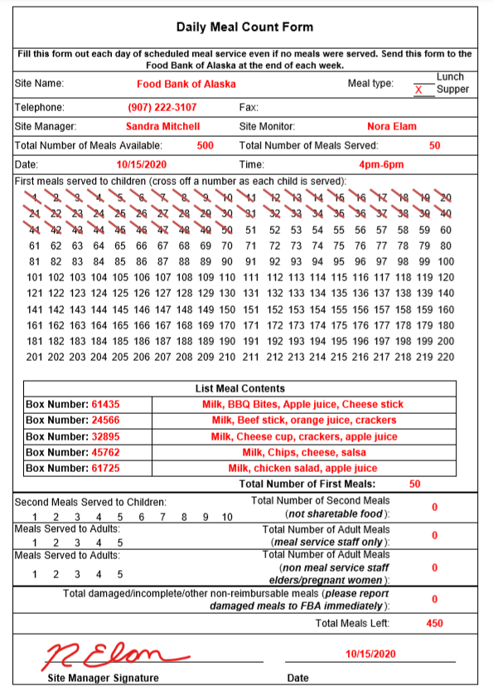
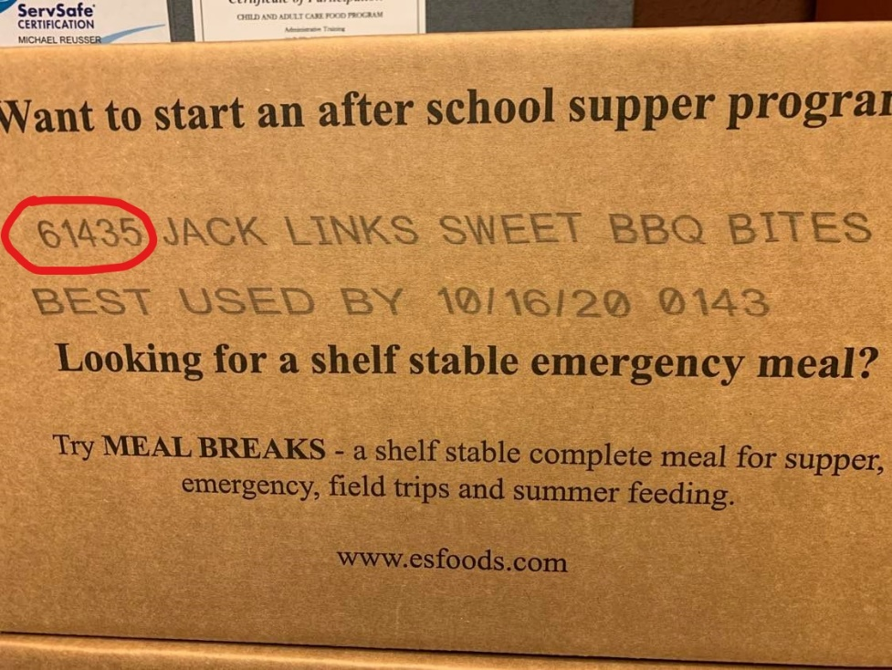
Example of Daily Meal Count Form
Everything in red is an example of what needs be filled out on every Meal Count form. If you ever have questions on how to properly fill out a Meal Count form, please contact FBA.
**This form cannot be altered in any way and must be filled at completely
Notes:
Stress how important tracking inventory is!!
A meal count must be completed for each day you serve meals along with a child roster of who received meals.
If you are in COVID-19 Lockdown a parent pickup form must be complete along with the daily meal count. When completing the meal count for a parent pick please put the date next to the meals distributed or complete a meal count form for each day.

Slide 27
Second Meals and Adult Meals
If kids eat their meal and come back for more, you should cross off numbers in the “Second Meals Served to Children” section; if you serve meals to adults, cross of numbers in the “Meals Served to Adults” section.
Limit second meals served to children
Limit number of meals served to adults
Notes:
If kids eat their meal and come back for more, you should cross off numbers in the “Second Meals Served to Children” section; if you serve meals to adults, cross of numbers in the “Meals Served to Adults” section.
Second Meals Served to Children- A limited number of second meals served can be claimed for reimbursement by the Food Bank of Alaska; please keep your second meals served to children low. When children ask for second meals, please first redirect them to the share table food items.
Meals Served to Adults- The program is meant to serve kids. You should not serve them to adults. If meal service site staff would like a meal they are able to have one. Meal service staff are Site Manager, Site Monitor and/or 1-2 regular program volunteers. These people would be marked in the meals served to adults meal service staff column.

Slide 28
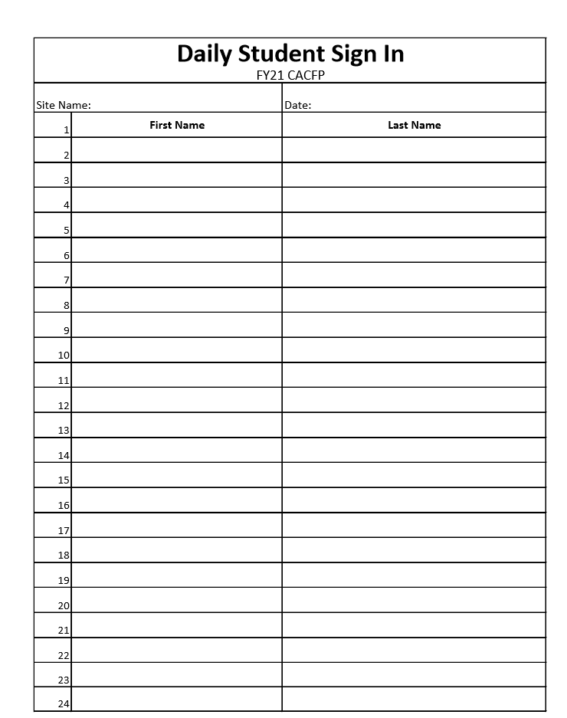
Daily Student Sign In Sheet
All children attending the program are also required to sign in on the attendance sheet every day a meal is distributed.
This is not required if you are filling out the Parent Pick Up Report

Slide 29
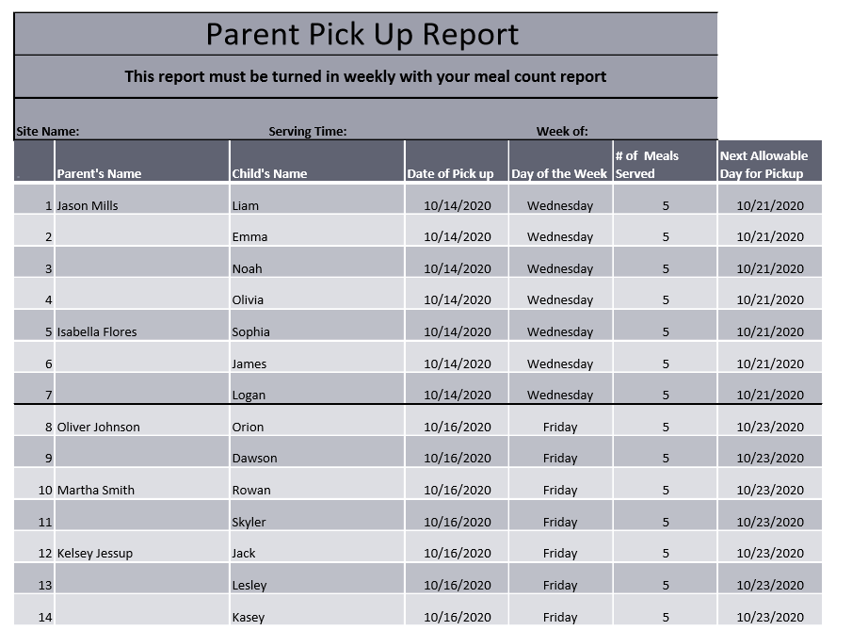
Parent Pick Up Report
If you are utilizing the Parent Pick up waiver due to COVID-19 restrictions or lockdown, You MUST fill out a Parent Pick Up Report in addition to your Meal Count form.
Example
Notes:
The Parent Pick Up report is also a very important form. In order for Food Bank of Alaska to be reimbursed for the meals from the State, we must be able to prove that children at each site are not being double served in one week. Before we are approved to run CACFP we submit the Parent Pick Up report to the State along with an explanation as to how it prevents children from being double served. Once they approve the form, they expect that the sites fill out the form the exact same way we have described it. Therefore, please do not alter this form in any way.

Slide 30
Requesting More Meals
We ask for a two-week notice on orders be given from the site to the Food Bank of Alaska in order to pick, process and ship the order before your site runs out of meals and milks. This will help to prevent a lapse in program service as well as ensure children aren’t going hungry unnecessarily.
Notes:
One thing we don’t want to see happen during the program is sites running out of meals. This requires the Food Bank of Alaska to have adequate notice when a site is running low on meals and will need another shipment. We ask for a two-week notice on orders be given from the site to the Food Bank of Alaska in order to pick, process and ship the order before your site runs out of meals and milks. This will help to prevent a lapse in program service as well as ensure children aren’t going hungry unnecessarily. As I previously stated, the inventory that is recorded on the Meal Count form helps us keep track of the inventory as well.

Slide 31
Shipping and Receiving
Orders typically take between 7-10 days once it has left our warehouse. When the shipments have left, we will send an email to the site containing information regarding the shipment such as:
The order number
How many cases of meals and milks
The date the shipment left the warehouse.
How it was shipped
When you have received your ENTIRE order, please sign and date the shipping invoice. Sites must email/fax the invoice back to the Food Bank of Alaska.
Notes:
The Food Bank of Alaska is responsible for sending out meals to CACFP sites during the duration of the program. Orders typically take between 7-10 days once it has left our warehouse. When the shipments have left, we will send an email to the site containing information regarding the shipment such as:
The order number
How many cases of meals and milks
The date the shipment left the warehouse.
How it was shipped
Upon receipt of the entire order, it will be the site’s responsibility to check the order and sign and date the shipping invoice. Sites must email/fax the invoice back to the Food Bank of Alaska. This will need to be done every time a shipment is received at your site.

Slide 32
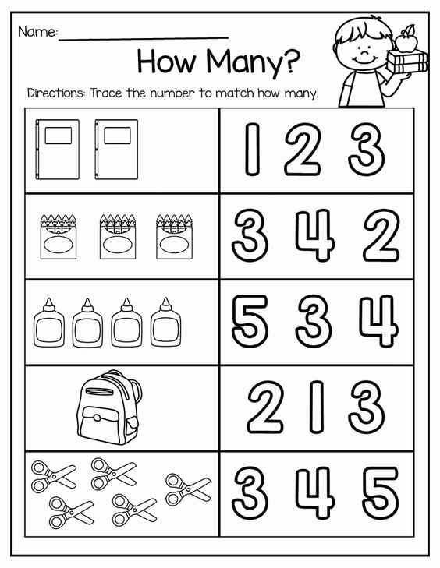
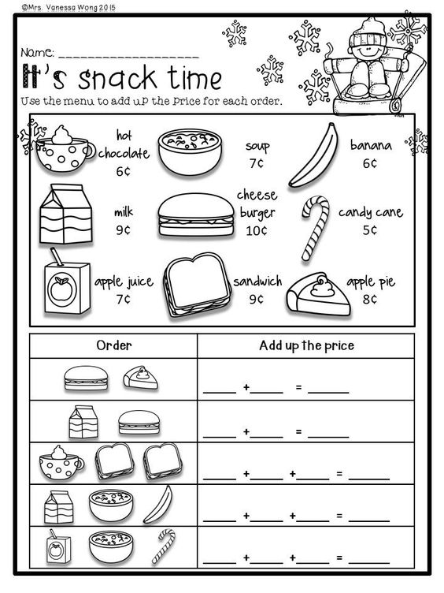
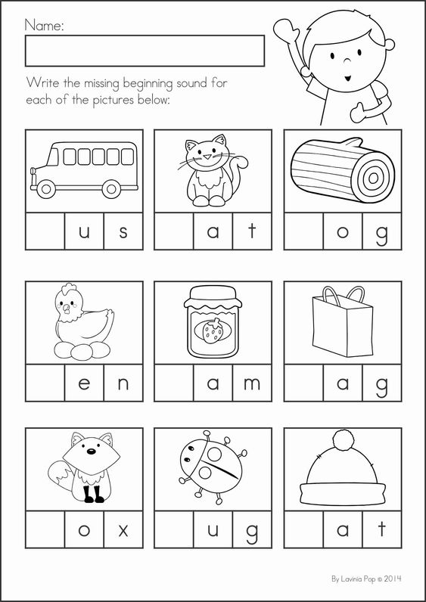
After school Activity Documentation
An afterschool activity during meal service is required in order to operate the program at your site.
If you are in COVID-19 lockdown this requirement will look different this year. Sites are encouraged to get creative in order to meet this requirement. Such as age-appropriate workbooks or worksheets.
Notes:
An afterschool activity during meal service is required in order to operate the program at your site. This can be something simple like a reading club, chess club, tutoring, etc. Please provide the Food Bank of Alaska with documentation of your site’s afterschool activity. If your site is in COVID-19 Lockdown and giving meals to children or parents to take home this requirement will look different this year. Sites are encouraged to get creative in order to meet this requirement. Some suggestions are giving out workbooks or worksheets at the beginning of the week and asking kids to return it the following week.

Slide 33
Site Manager and Monitor Training

Slide 34
Memorandum of Agreements
The Memorandum of Agreement is a document that must be read in full and filled out. This document is an agreement between the Site Manger/Site Monitor and the Food Bank of Alaska. It states the duties that each roll requires. If you have not filled out the MOA yet, please do so and email or fax to FBA.

Slide 35
Manager Role
The role of the Site Manager is integral to a successful CACFP program. The responsibilities of a Site Manager are:
Serve meals to needy children who are 18 years or younger regardless of race, color, national origin, sex, age or disability.
Complete the daily meal count form, student sign in, and parent pick up report (if applicable) at each meal service and submit it to FBA weekly.
Set up and take down the meal service area.
Supervise the meal service.
Communicate with FBA about food inventory levels
Notes:
The role of the Site Manager is integral to a successful CACFP program. The Site Manager must create a relationship with the Site Monitor to ensure that required site visits are conducted on time, and service is being operated within the program guidance requirements. The Site Manager must also have consistent communication with FBA. The responsibilities of a Site Manager are:
Serve meals to food insecure children who are 18 years or younger regardless of race, color, national origin, sex, age or disability.
Complete the daily meal count form, student sign in, and parent pick up report (if applicable) at each meal service and submit it to FBA weekly.
Set up and take down the meal service area.
Supervise the meal service.
Communicate with FBA about food inventory levels

Slide 36
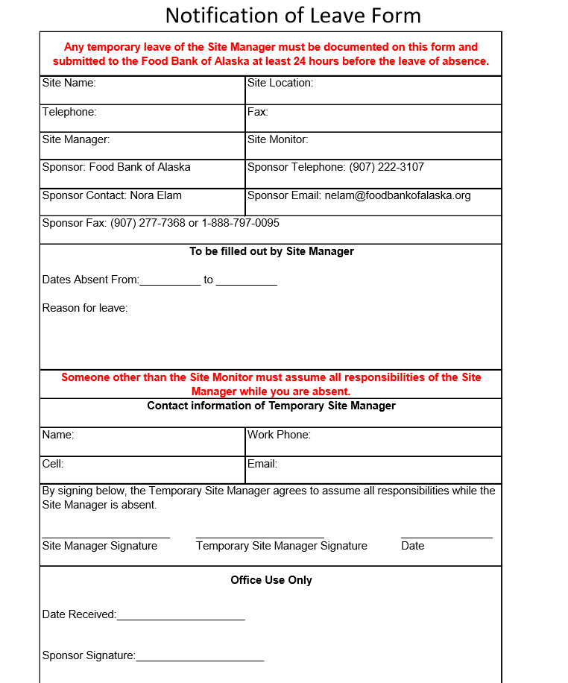
Site Manager Notification of Leave
If a Site Manager takes any leave of absence during their participation in CACFP they must fill out a Notification of Leave Form and submit it to FBA at least 24 hours before their leave. They must also appoint a Temporary Site Manager to assume all responsibilities while they are gone.

Slide 37
Monitor Role
The role of Site Monitor is very important. You are the link between FBA and the site, and we rely on you to ensure that the sites operate in accordance with program guidance and requirements. The responsibilities of the Site Monitor are:
The monitor should oversee the distribution at least 3 times during the program to ensure that only kids are being served meals, that meals are being eaten on site (unless parent/child picking up meals), and that the program is running smoothly.
The monitor may not be affiliated (either through family relation or through a business/employer relationship) with the organization/group running the CACFP meal service.
**If the Site Monitor changes please let FBA know immediately. And send the new monitor information and signed MOA.
Notes:
The role of Site Monitor is very important. You are the link between FBA and the site, and we rely on you to ensure that the sites operate in accordance with program guidance and requirements. Site Monitors must develop and maintain open communications and cooperative relationships with Site Managers. Site Monitors will also work with the Site Manager to correct any problems. To be an effective monitor, you are required to spend enough time at the site to observe the meal service operation. The responsibilities of the Site Monitor are: The monitor should oversee the distribution at least 3 times during the program to ensure that only kids are being served meals, that meals are being eaten on site (unless parent/child picking up meals), and that the program is running smoothly.
The monitor may not be affiliated (either through family relation or through a business/employer relationship) with the organization/group running the CACFP meal service.
**If the site monitor changes please let FBA know immediately. And send the new monitor information and signed MOA.

Slide 38
Monitoring Review Dates
1st review due within first month of operating the program
2nd review due within first three months of programing
3rd review due prior to program closing in May
Notes:
Site Monitors are required to also fill out a form at each review. Reminder emails 2 weeks and 1 week prior to the review date will be sent out to the Site Monitor along with the required paperwork. It is important to conduct the review on the assigned date, and send back the completed form to Food Bank of Alaska no later than one week after the site visit.

Slide 39
The Food Bank of Alaska thanks you for participating in today’s Child and Adult Care Food Program training. We would also like to thank you for being a site that is helping to eliminate hunger among Alaska’s youth.
If you have any questions or concerns, please reach out to Nora Elam:
Email: smitchell@foodbankofalaska.org
Direct Line: (907) 222-3104
Fax: 1-888-797-0095

Slide 40
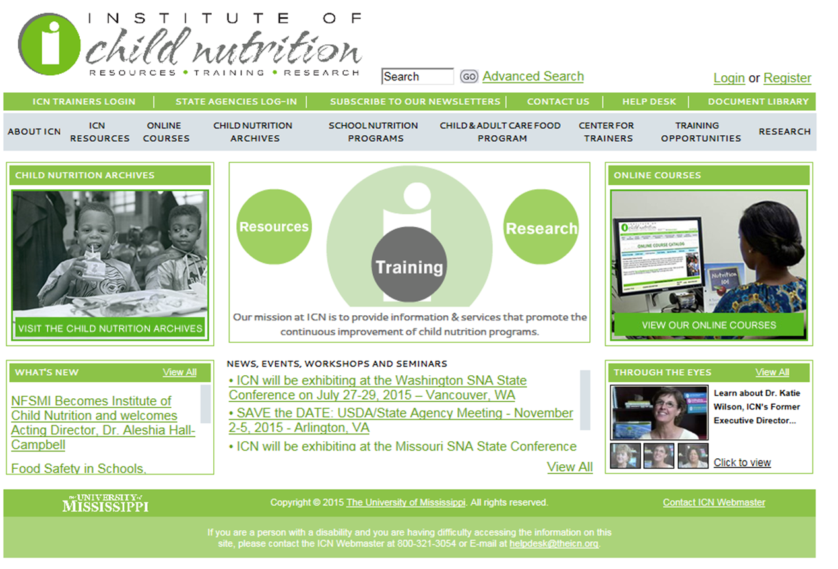
Additional Resources
Institute of Child Nutrition:
https://theicn.org/

Slide 41
https://education.alaska.gov/cnp/cacfp1

Slide 42
https://www.fns.usda.gov/cacfp/afterschool-programs

